Slide 1
GURUGU SAI GIRIJA
Final Project
3/21/2024 Annual Review

Slide 2
PROJECT TITLE
KEYLOGGER
3/21/2024 Annual Review

Slide 3


AGENDA
Keyloggers are surveillance tools designed to monitor and record every keystroke made on a keyboard. They are often used with the intention of capturing sensitive information, such as login credentials, financial data, and personal communications. While keyloggers can have legitimate uses, such as monitoring employees or parental control, they are primarily associated with malicious activities.
Cybercriminals frequently use keyloggers to steal confidential information, which can lead to identity theft, financial fraud, and unauthorized system access. The presence of keyloggers poses significant security threats, including privacy invasion, data breaches, and the potential for wider malware infections that can compromise overall system integrity.
To mitigate these risks, it is essential to:
Raise Awareness
Implement Technical Defenses
Conduct Regular Security Audits
3/21/2024 Annual Review

Slide 4

PROBLEM STATEMENT
Despite the growing sophistication of keylogger attacks, many individuals and organizations lack the necessary understanding and implementation of effective security measures. This gap in knowledge and preparedness results in heightened vulnerability to privacy invasions, financial fraud, and data breaches.
3/21/2024 Annual Review

Slide 5

PROJECT OVERVIEW
The presentation will then explore the mechanisms through which key loggers operate, how they capture keystrokes, and how this information is transmitted to attackers. We will discuss the potential impacts of key loggers, from personal risks like identity theft and financial loss to corporate risks including data breaches and intellectual property theft .We will delve into the detection of key loggers, examining symptoms, indicators, and the tools available for identifying them. Preventive measures will be highlighted, emphasizing the importance of regular software updates, comprehensive security solutions, physical security of devices, and safe online practices. We will also cover response strategies for key logger infections, outlining steps to remove key loggers and secure affected accounts.
3/21/2024 Annual Review

Slide 6

WHO ARE THE END USERS?
The primary end users of this presentation on "Key Loggers and Security" are:
1)Individuals and General Public
2)Corporate Employees and Management
3)IT and Security Professionals
4)Educational Institutions and Students
5)Government and Law Enforcement Agencies
6)Healthcare Providers
3/21/2024 Annual Review

Slide 7

YOUR SOLUTION AND ITS VALUE PROPOSITION
Our solution to combat the escalating threat of keyloggers is a comprehensive, multi-faceted approach that includes raising awareness, implementing advanced technical defenses, and establishing robust response protocols. By conducting targeted educational campaigns, we equip users with the knowledge to recognize and avoid keylogger threats. Our deployment of cutting-edge antivirus software, encryption, and two-factor authentication ensures a robust defense against potential attacks. Furthermore, we implement sophisticated detection and monitoring systems to identify keylogger activities early. In the event of an attack, our well-defined response protocols enable swift and effective action to mitigate damage and secure compromised data. This solution not only reduces the incidence and impact of keylogger attacks but also enhances overall cybersecurity posture, fostering a safer digital environment. The value proposition lies in significantly lowering the risk of data breaches, financial losses, and privacy invasions, thereby safeguarding personal and organizational integrity and ensuring business continuity.
3/21/2024 Annual Review

Slide 8

THE WOW IN YOUR SOLUTION
Revolutionizing Security: Our solution delivers unparalleled protection against key logger attacks, transforming the landscape of digital defense. Through cutting-edge education, advanced detection tools, and proactive measures, we redefine security standards. Experience the 'wow' factor of peace of mind, cost savings, and enhanced trust, setting new benchmarks in safeguarding individuals and organizations."
3/21/2024 Annual Review
8

Slide 9
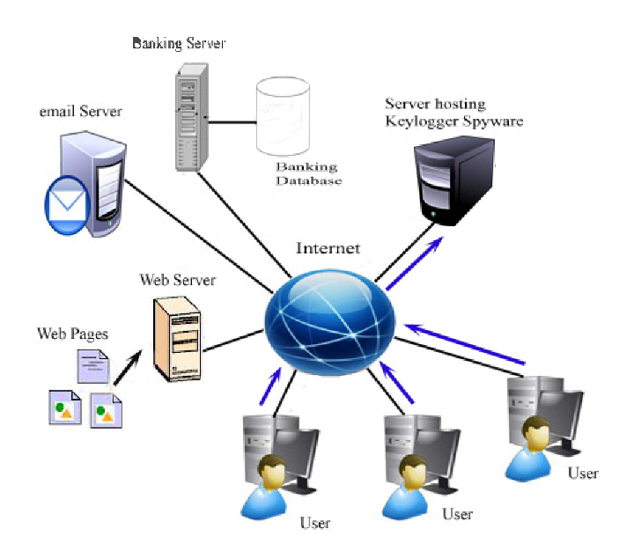
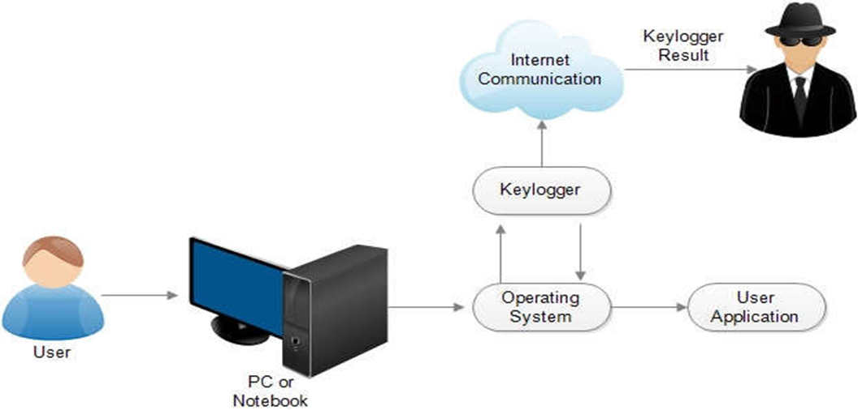
MODELLING
Teams cam add wireframes
3/21/2024 Annual Review
9

Slide 10
RESULTS
Our comprehensive security strategy delivers outstanding results, significantly reducing the risk of keylogger attacks. Through enhanced awareness and preparedness, users are equipped to recognize and avoid threats. Advanced detection tools and proactive measures ensure robust protection, while clear incident response plans guarantee swift, effective action. The outcome? Peace of mind, cost savings, reduced risk, and strengthened trust, safeguarding financial and reputational integrit
"Don't Let Keyloggers Infiltrate Your Security."
3/21/2024 Annual Review
10

